Slide 1

capstone mock
F1- Lap time analysis
BY ALI JAAFAR

Slide 2

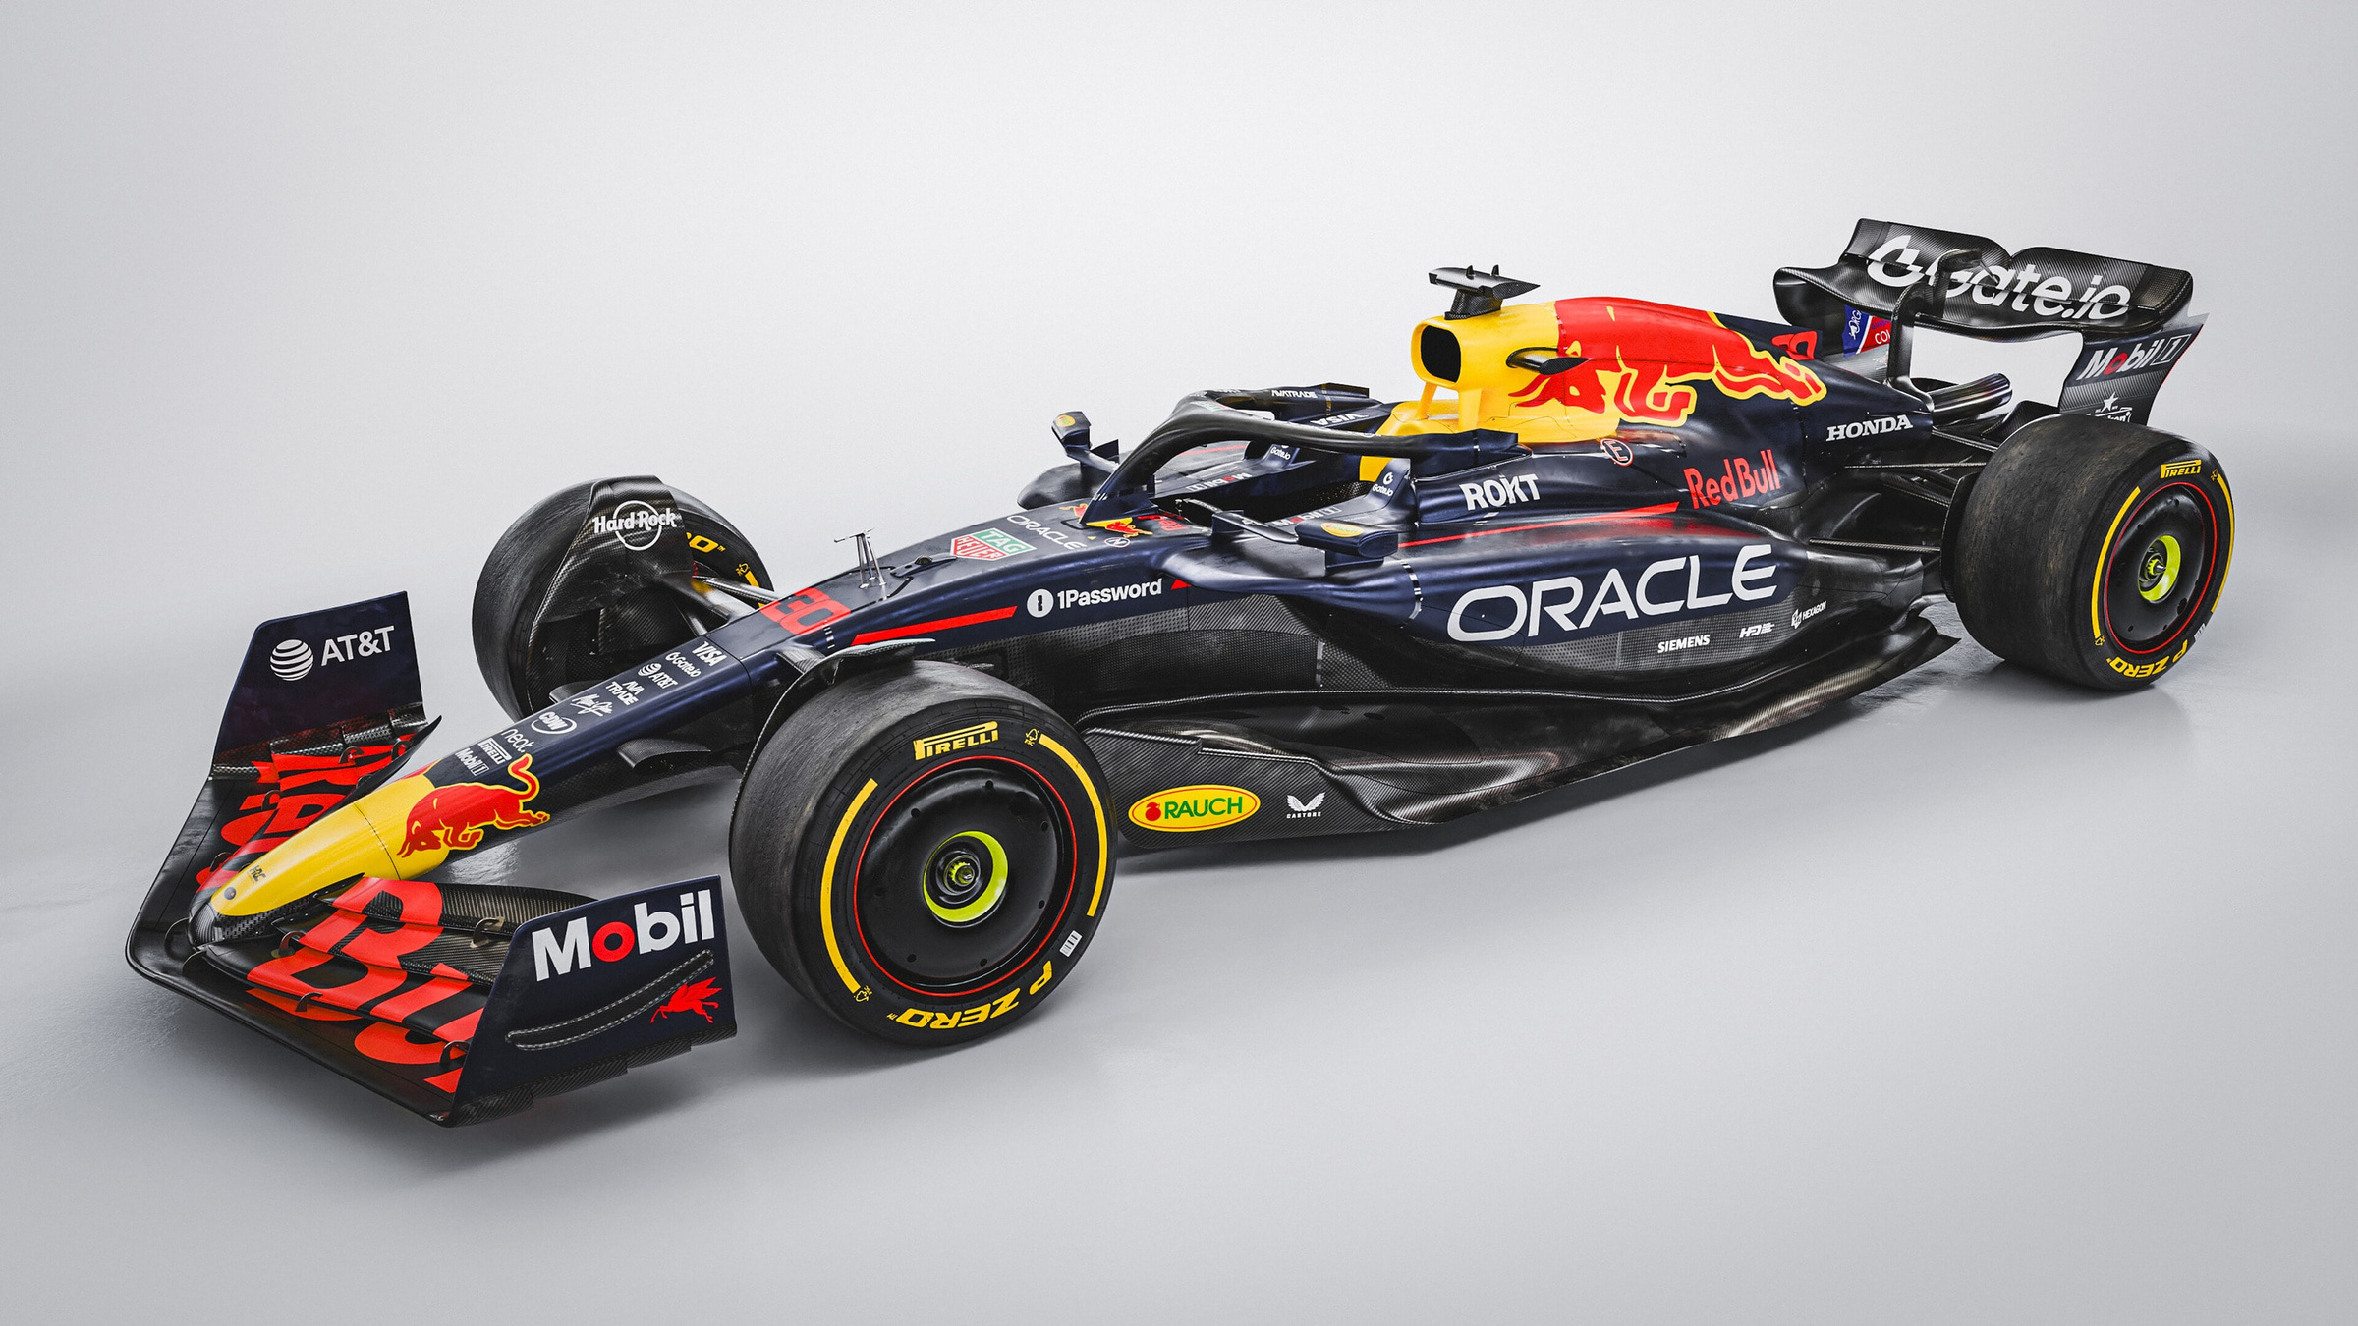
Problem statement
Race results alone often fail to explain the dynamics that shape a Grand Prix. While lap-time data captures the pace and performance of every driver across a race, it is rarely analyzed in depth to uncover why outcomes unfold the way they do. Without this deeper view, race control operators, officials, analysts lack critical insight into the patterns of driver performance, the impact of weather, and the relationship between starting and finishing positions.
and most importantly is what is the main thing that make one driver is champion over a nother
“How do conditions shape results?”

Slide 3

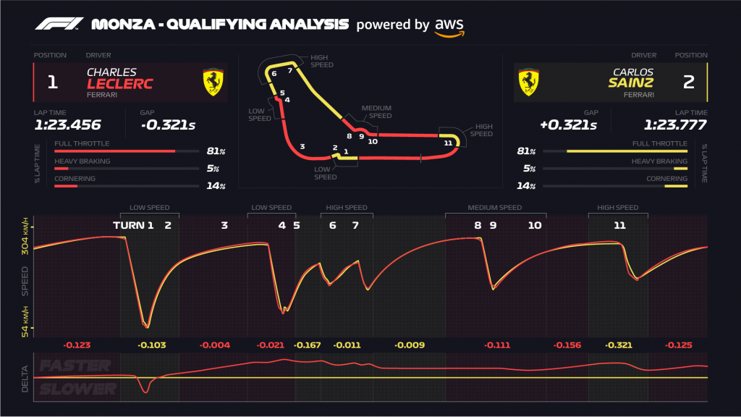
What I Aim to Achieve
This project uses detailed lap-time analysis—augmented with finishing position, starting position, weather, and winner context—to go beyond final results and reveal the hidden performance stories of each race. The aim is to provide actionable insights for

Slide 4

Who is This For?
Race Stewards & Sporting Officials (FIA)
race control operators
Motorsport Analysts
New Fans

Slide 5
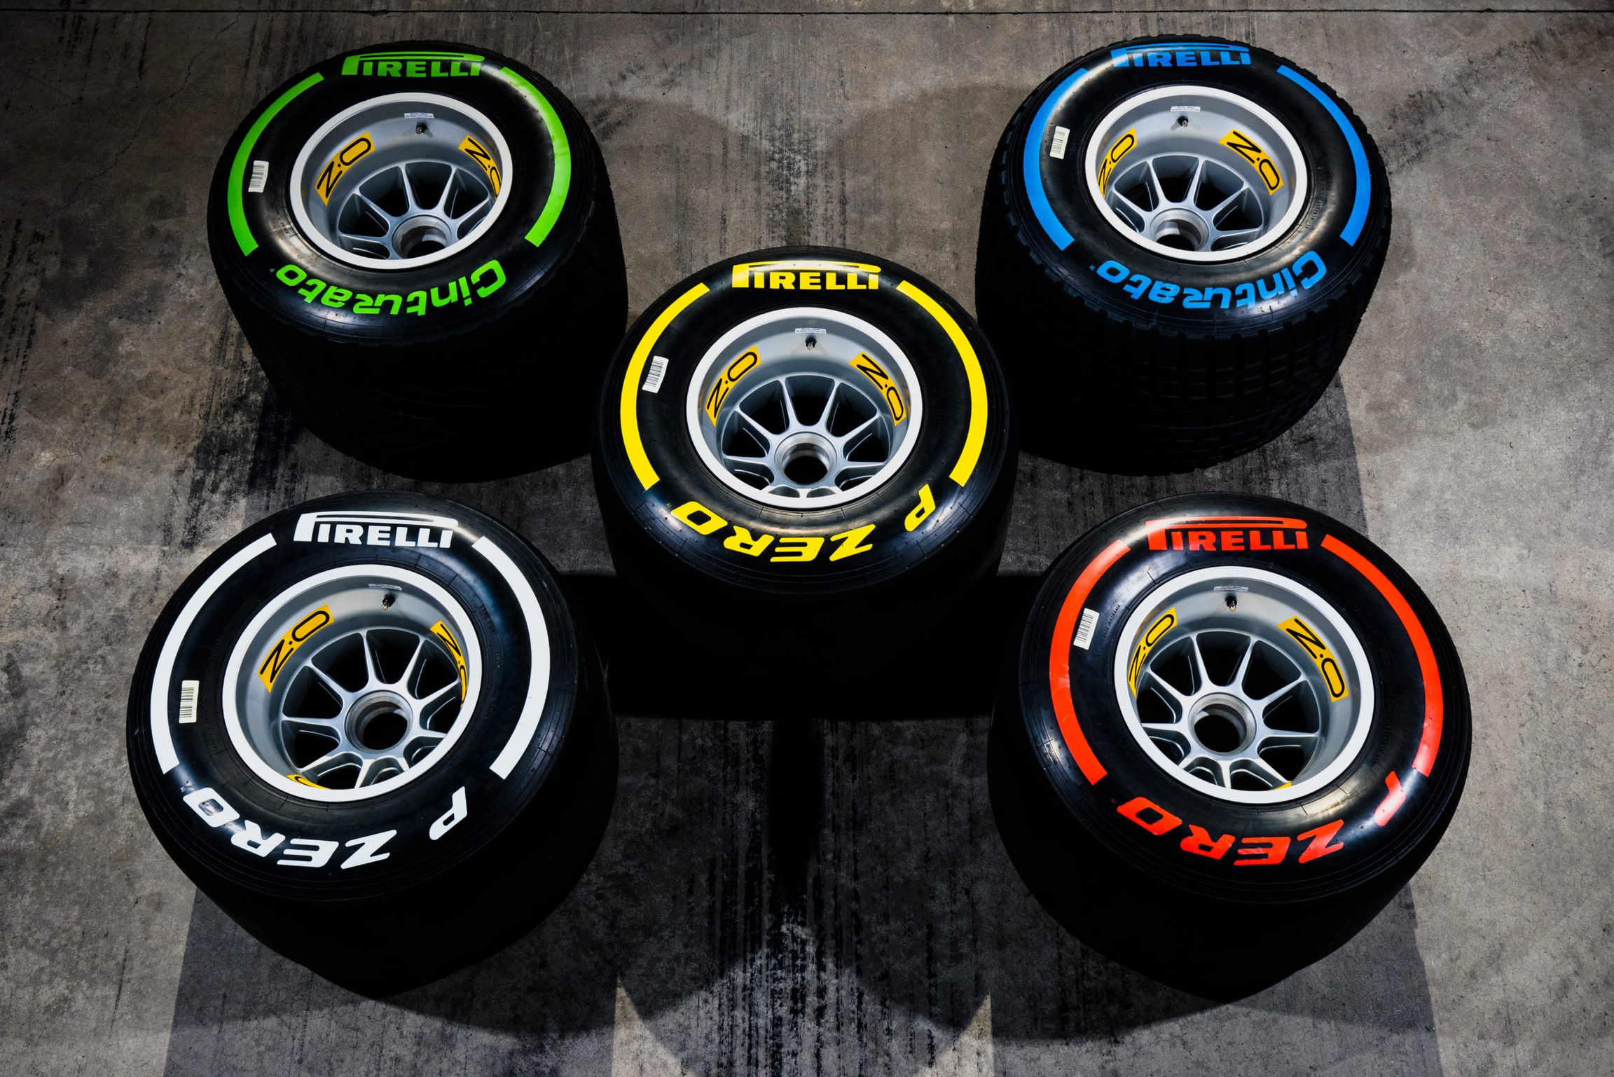
About the Dataset
Dataset: 2019–2021 F1 lap times (~60k rows).
Key Columns: Driver, Team, Lap Time, Sector Times, Tyre Compound, Weather, starting Position and Finishing position.
EDA Findings:
Missing laps in some races (15 races from 2021).
Outliers: DNFs
Tire usage patterns: Softs fade after 15–20 laps.
Weather grouped: Dry, Wet.
New columns: weather, winner, starting position and Finishing Position → enables performance vs result analysis

Slide 6
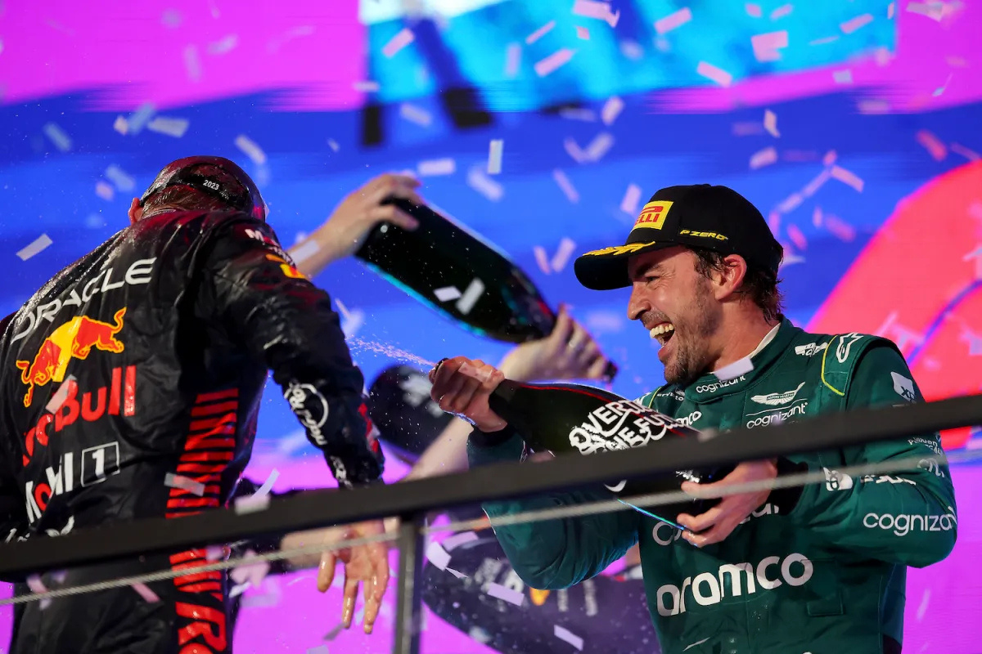





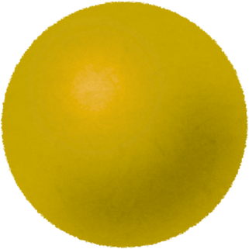



what is formula one ?
The highest level of car racing in the world
Cars can go 300+ km/h
Each race = Grand Prix (GP)
A season has 20–24 races around the world
Points = based on finishing position
Most points at season’s end = World Champion
Ferrari, Mercedes, Red Bull, etc.
Each team has 2 drivers
Team points = Driver 1 + Driver 2
Most points = Constructors’ Champion
🏁 points distrebution
1st place → 25 points
2nd place → 18 points
3rd place → 15 points
4th place → 12 points
5th place → 10 points
6th place → 8 points
🌍 When & Where They Race?
Season: March → December
Tracks all over the world:
🛞 tyres
🇲🇨 Monaco (street race)
🇮🇹 Monza (very fast)
🇧🇭 Bahrain (night desert race)
🇦🇪 Abu Dhabi (season finale)
Soft = fastest, wears quickly
Intermediate = light rain
Medium = balanced
Wet = heavy rain
Hard = durable, slower

Slide 7
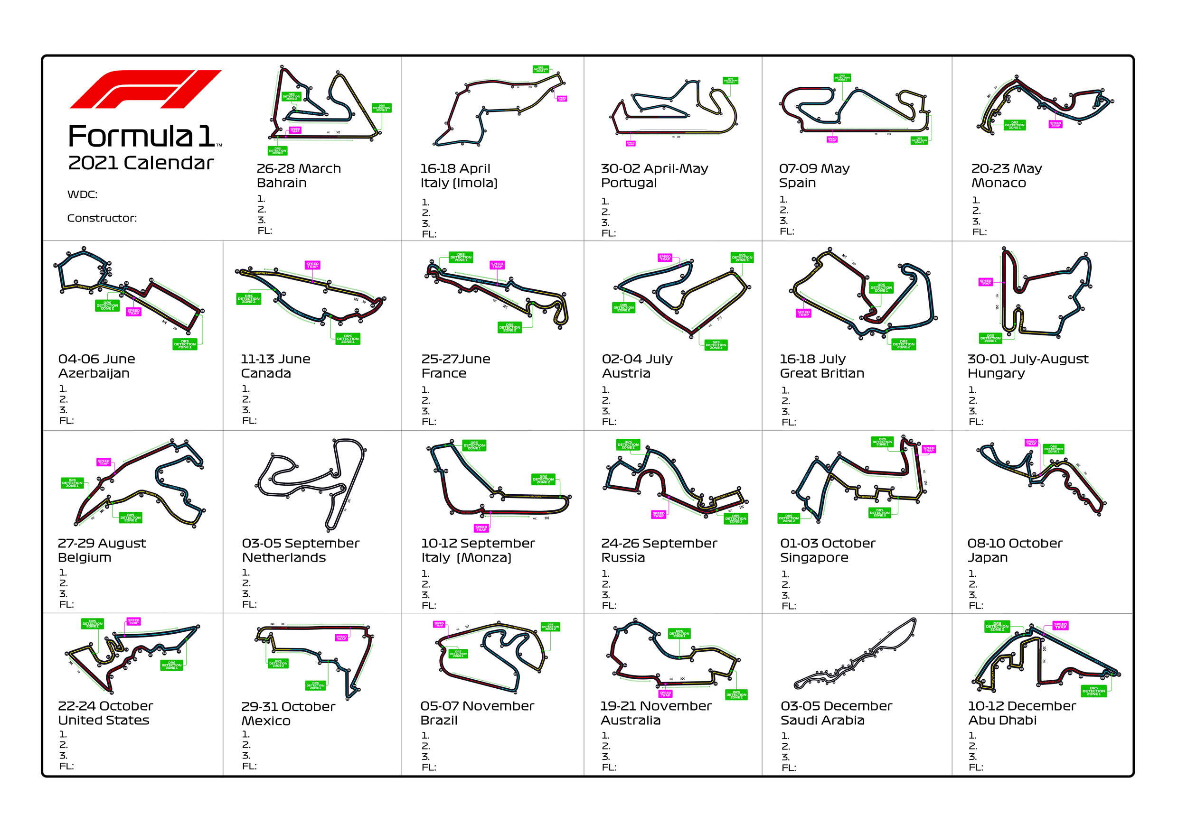
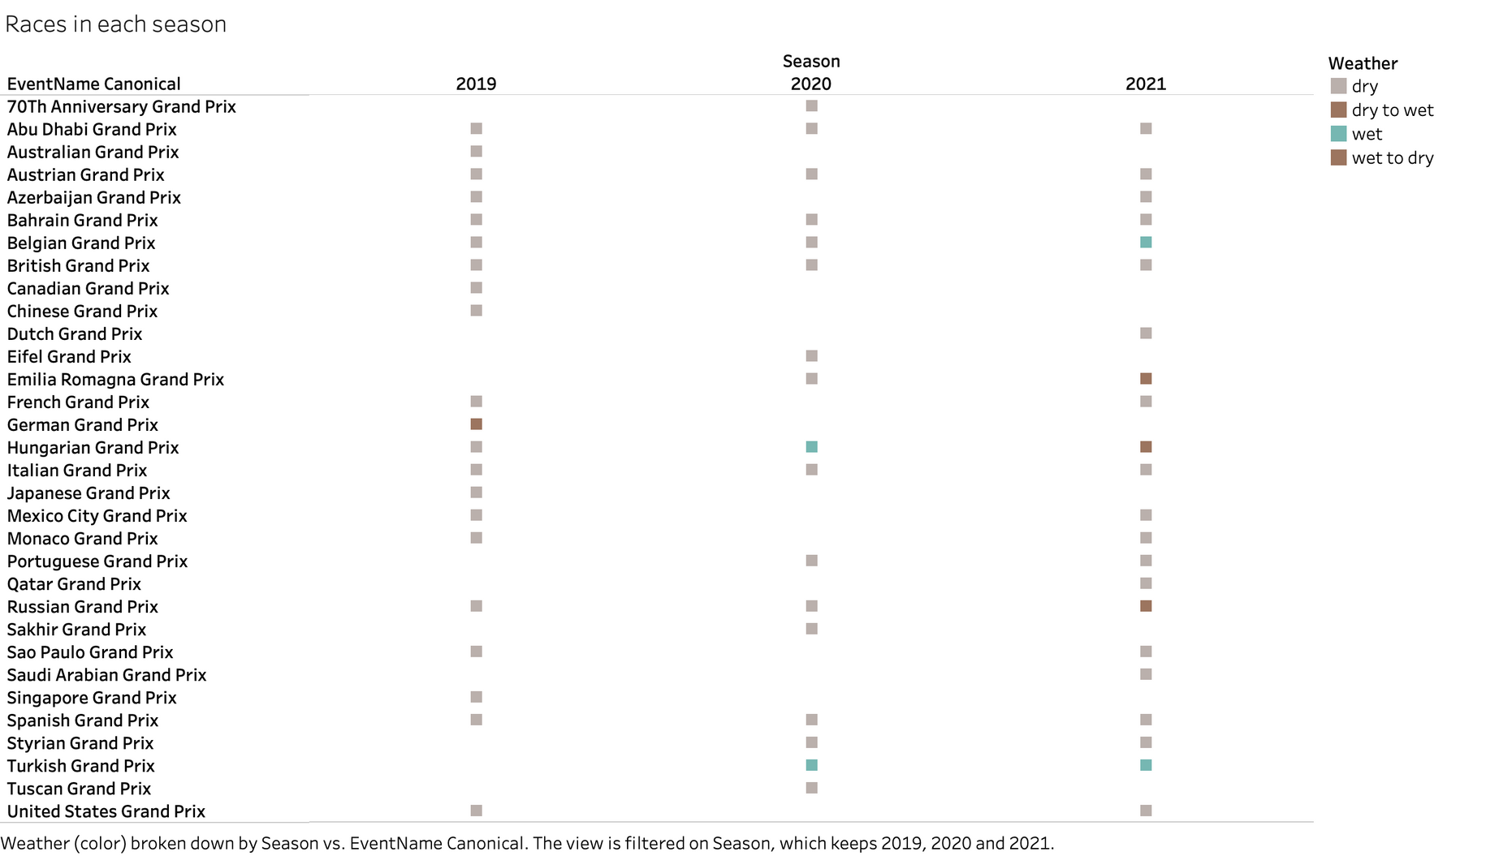
Races we cover

Slide 8
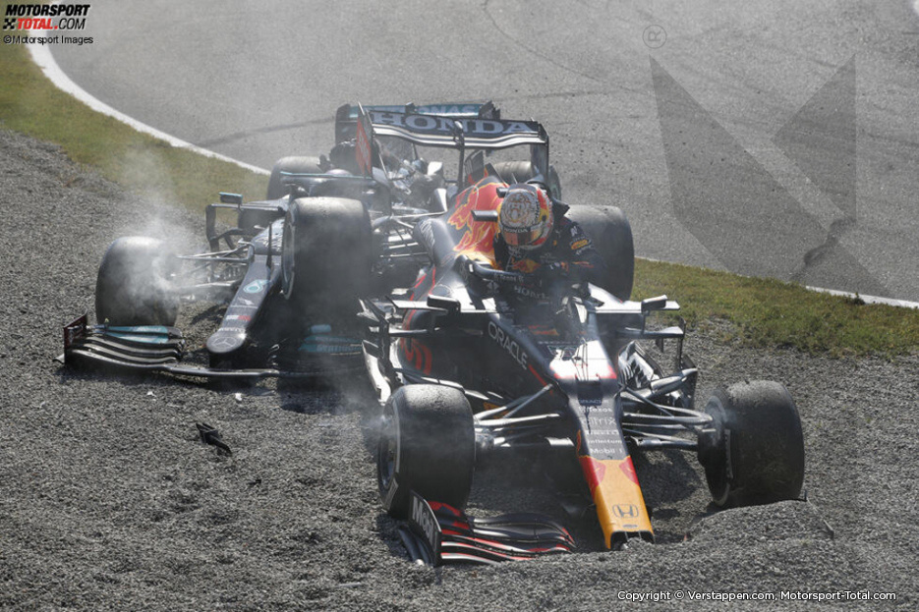
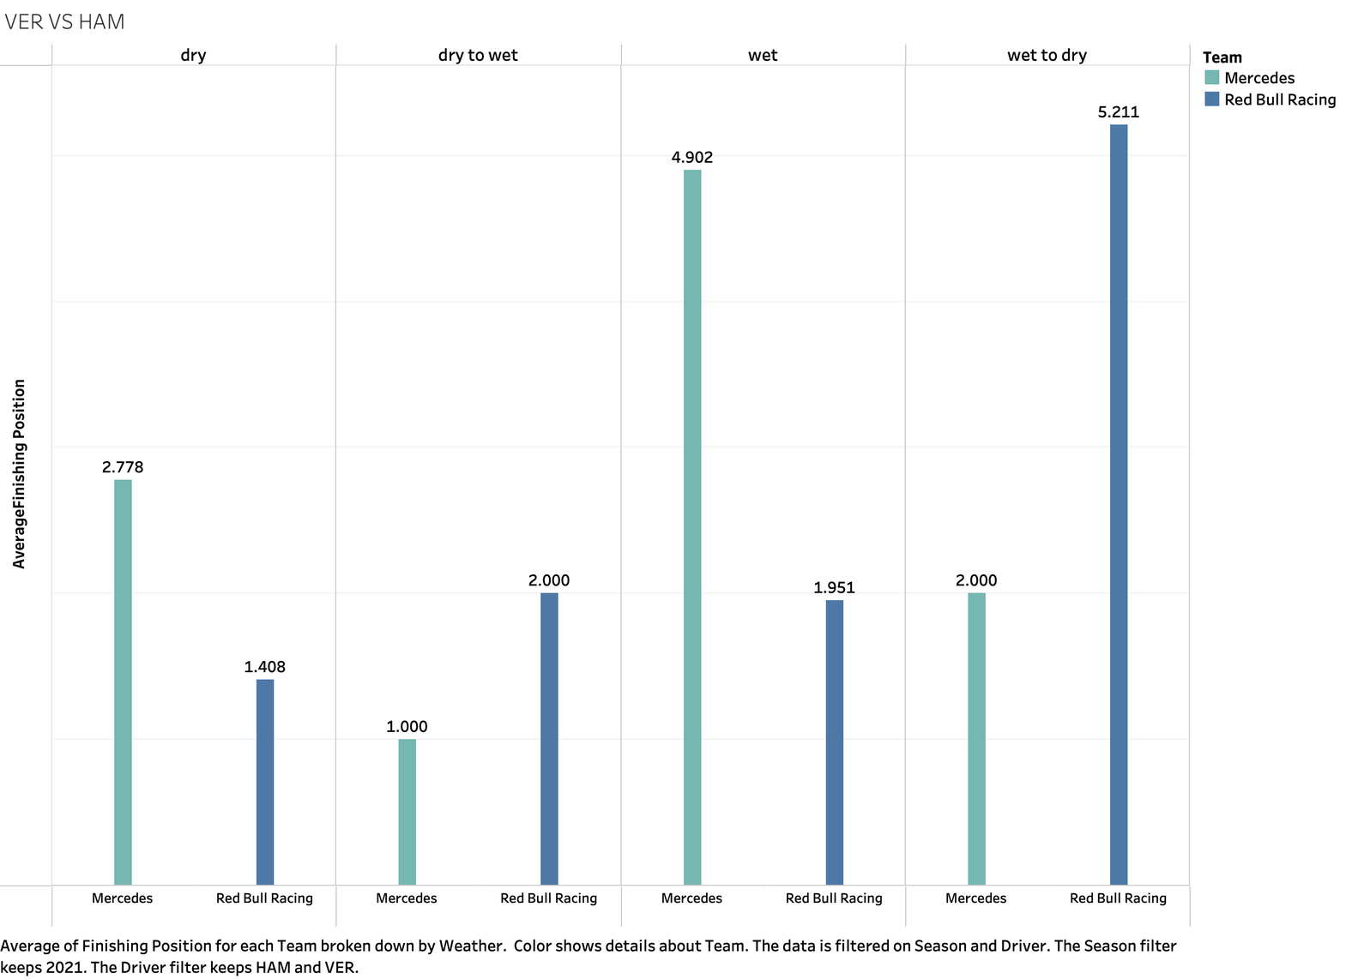
finishing position on avg.
comparing the average finishing position for the two championchip protagenes in 2021 in the wet and dry conditions

Slide 9
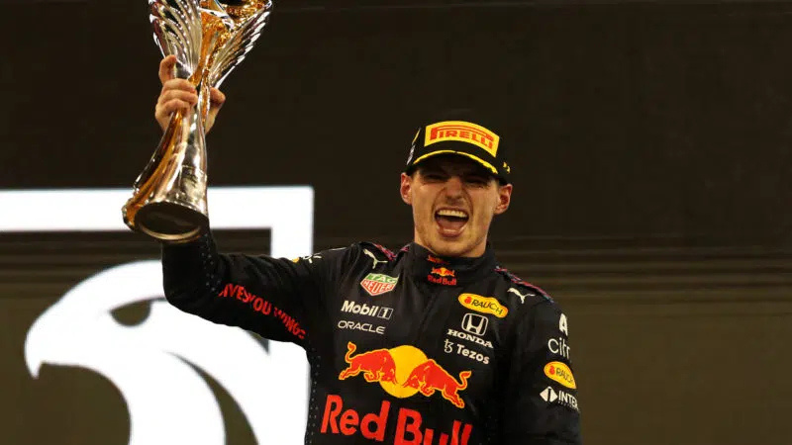
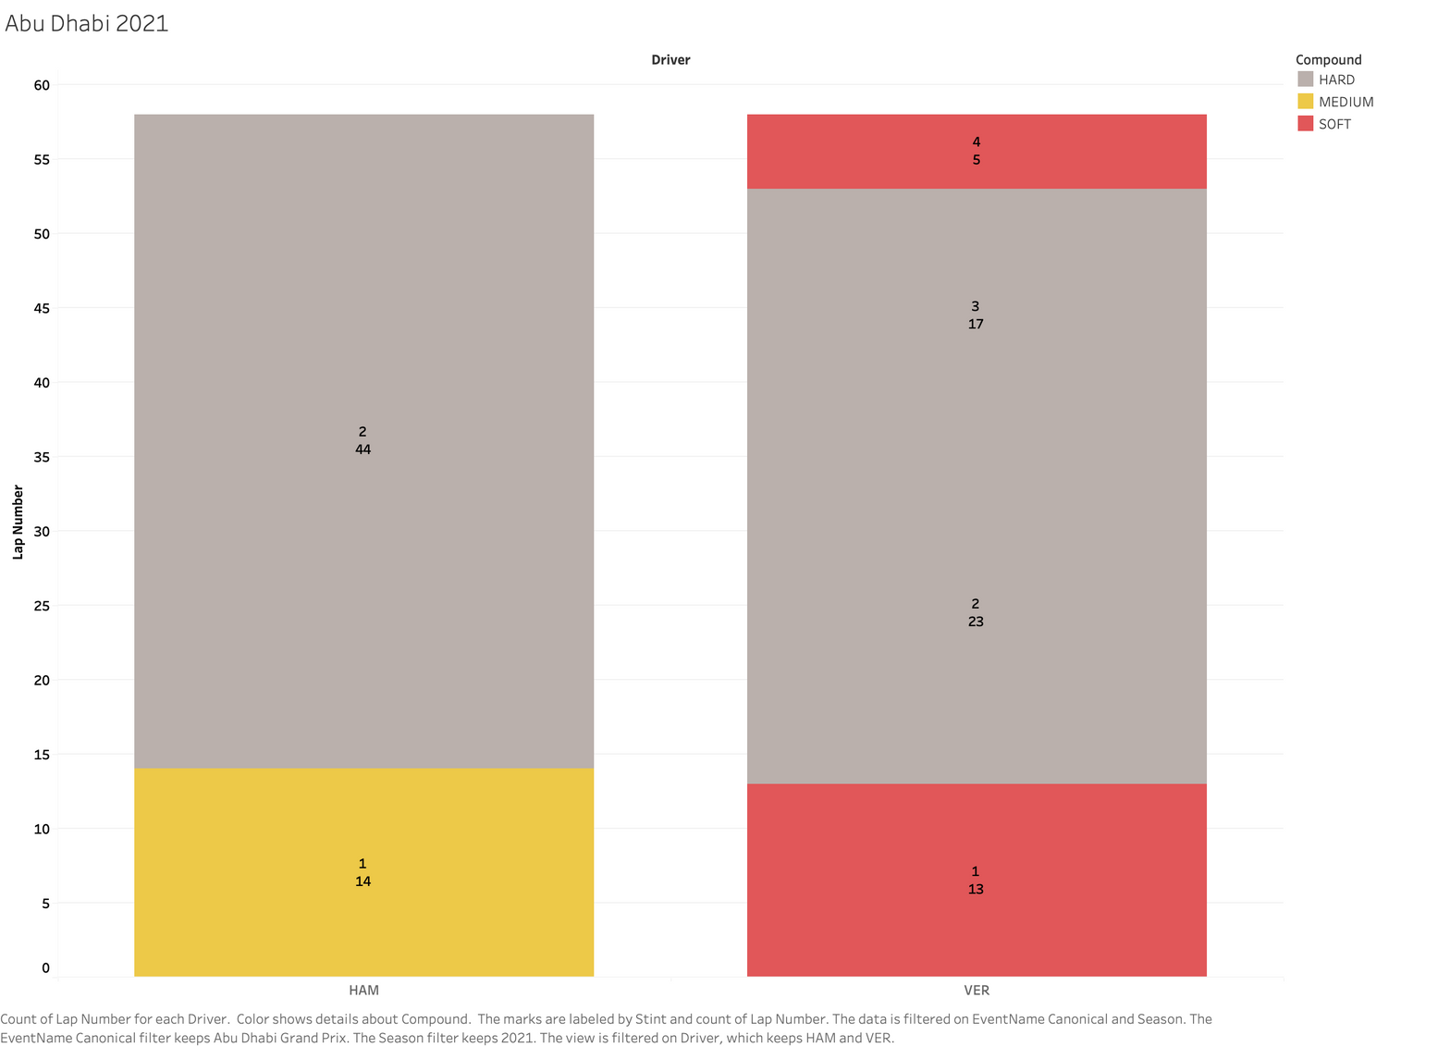
strategy difference
by changing the tyre in the last 5 laps VER has won his first championship

Slide 10

Thank You

